Slide 1
The Impact of AI Tools on Students' Learning Experience
Assignment 2: Survey Development & Analysis
Presented by: M. Sajid Bashir, Nicolas Bernal, Emma Desbois
Student – TU Wien
105.708 Data Acquisition and Survey Methods (VU 2.0)
23 June 2025

Slide 2

Research Questions
?
Do students who use AI tools complete their academic tasks in less time while maintaining or improving the quality of their work compared to those who do not use AI tools?
RQ1
Does the frequency of AI tool usage increase students’ motivation and engagement during their studies?
RQ2
Do students who include AI tools into their study routines demonstrate better long‑term retention of learned material compared to those who do not?
RQ3

Slide 3
Survey Design
1
TU Wien students from programs such as Data Science, Computer Science, and Business Informatics
Target Group
2
Online survey with both quantitative and categorical questions
Data Collection Method
3
98 participants
Total Respondents
4
Demographics (age, gender, program)
AI tool usage and frequency
Opinions on time-saving, quality, motivation, and retention (Likert-style)
Question Types

Slide 4
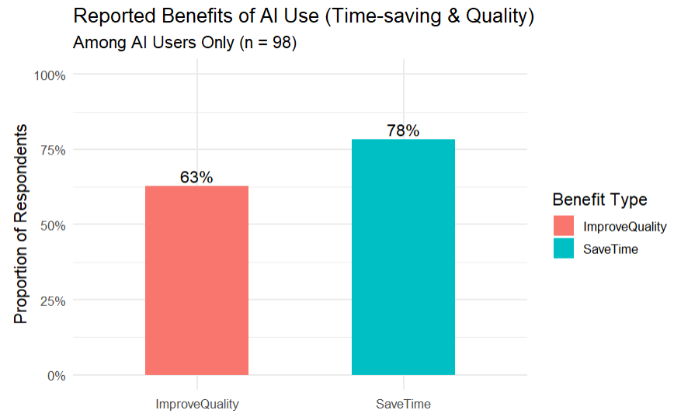
Exploratory Data Analysis – RQ1: Time-Saving & Quality Improvement
Research Question:
Do AI tools help students complete academic tasks faster and with better quality?
Findings:
78% of AI users said AI tools saved them time
63% reported improved quality of academic work
Analysis based on 98 AI-using students
No comparison to non-users was possible due to lack of data

Slide 5
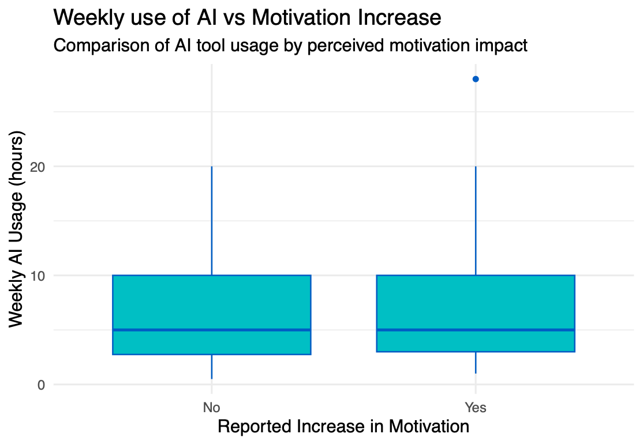
Exploratory Data Analysis – RQ2: Motivation vs. AI Usage Frequency
Research Question:
Does the frequency of AI tool usage increase students’ motivation and engagement?
Findings:
Median, first quartile, and third quartile of weekly AI usage are nearly identical for both groups (5, 4, and 10 hours respectively).
This suggests no significant difference in AI usage between those who reported an increase in motivation and those who did not.

Slide 6
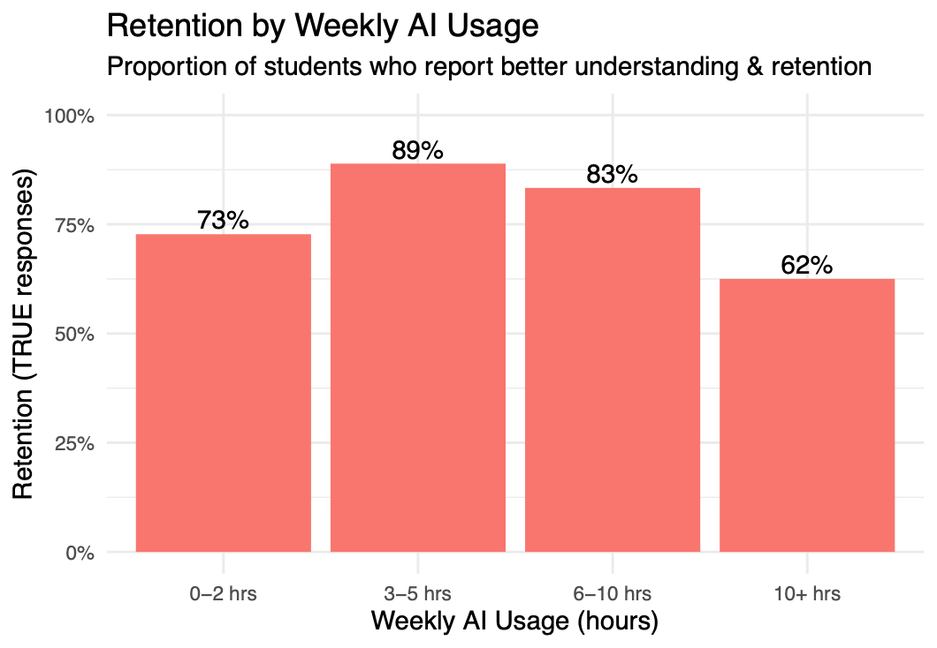
Exploratory Data Analysis – RQ3: Retention vs. AI Usage Frequency
Research Question:
Do students who use AI tools more frequently report better long-term retention of learned material?
Findings:
3–5 hrs/week users reported the highest retention (89%)
6–10 hrs/week also high (83%)
Retention drops for 10+ hrs/week (62%)
Moderate usage appears more effective for retention than excessive usage

Slide 7
Descriptive Inference – Summary Statistics
Variable | Mean | SD | Min | Max
Age | 26.04 | 3.93 | 20 | 45
AI Hours | 7.0 | 5.7 | 0.5 | 28
Age
Average age was 25.8 years, with a few possible outliers on the largest ages.
Summary Statistics
Weekly AI Usage
Students used AI tools for an average of 7.0 hours/week, with a few high-usage outliers skewing the data.

Slide 8

Analytic Inference – RQ1: Time-Saving & Quality (Binomial Test)
Research Question
Do AI tools help students complete academic tasks faster and with better quality?
Statistical Test
RQ1
One-sample binomial test (tested against 50% baseline)
Results
Interpretation!
Time-saving: 78% agreed, p < 0.00001 → significant
Quality improvement: 62% agreed,
p = 0.0098 → significant
A statistically significant majority of AI users report both time-saving and quality benefits.

Slide 9

Analytic Inference – RQ2: Motivation & AI Usage (Logistic Regression)
Research Question
Does the number of hours spent using AI tools per week predict students' motivation levels?
Statistical Test
RQ2
Logistic regression
Outcome: Motivation (binary)
Predictor: AI Hours (numeric)
Results
Interpretation!
Coefficient for ai_hours: 0.005
p-value: 0.867
Interpretation: Not statistically significant
No significant relationship found between AI usage hours and reported motivation.

Slide 10
Analytic Inference – RQ3: Retention & AI Usage (Logistic Regression)
Research Question
Does weekly AI usage predict whether students report better understanding and long-term retention?
Statistical Test
RQ3
Logistic regression
Outcome: Retention (binary)
Predictor: AI Hours (numeric)
Results
Interpretation!
Coefficient for ai_hours: -0.041
p-value: 0.31
Interpretation: Not statistically significant
No significant relationship found between weekly AI usage and reported retention.”

Slide 11

Discussion & Conclusion
“AI tools are widely used and perceived as beneficial, especially for task efficiency and quality. However, their effect on motivation and learning retention is less clear.”
RQ1: Significant majority of students reported time-saving (78%) and improved quality (62%) using AI tools
RQ2: No significant link between weekly AI use and reported motivation
RQ3: No significant link between weekly AI use and perceived retention

